Slide 1

JOB ROLE SALARY ANALYSIS
(Salaries of Different Data Science Roles in the Data Science Domain)
Designed by:
Tosin Ogunsemore

Slide 2
Introduction
Data Science is a rapidly growing field, and Data scientists play a crucial role in analyzing and interpreting large volumes of data. In the technological space, it is a field and profession well sought after. Thus demanding importance to understand basic factors that influences the salaries of data scientists across the globe.
This project focuses on analyzing the factors that impact salaries of employees on a global scale across various region.
To achieve this, the dataset on employee salaries for different roles was obtained and analyzed using the key variables such as experience level, Region, Company_size, etc. this report describe the relationship between these variables and the employee salaries using EDA (Exploratory Data Analysis).

Slide 3
Project Objectives
Analyze Remote Work Trends and Their Impact on Compensation
Identify Key Factors Influencing Salary Levels
Evaluate Geographic Differences in Data Science Compensation
Understand Salary Distribution Across Experience Levels
Assess the Relationship Between Company Size and Compensation

Slide 4
Variables:
Work_year: The year in which the salary data was recorded. (2020-2022)
Experience_level:The experience level of the employee.
EN (Entry-level), MI (Mid-level), SE (Senior-level), and (Executive-level)
Employment_type: The type of employment contract.
FT (Full-time), PT (Part-time), CT (Contract), and FL (Freelance)
Job_title: The job title or position of the employee. (e.g., Data Scientist, Data Analyst).
Salary: The salary amount, possibly in local currency.
Salary_currency: The currency in which the salary is paid (e.g., USD, EUR, GBP).

Slide 5
Variables (cont’d)
Salary_in_usd: The salary amount converted to USD for standardization.
Employee_residence: The country where the employee resides.
Remote_ratio:The percentage of time the employee works remotely.
0 (In Office), 50 (Hybrid), and 100 (Fully remote)
Company_location:The country where the employing company is located. (e.g., US, GB, DE).
Company_size: The size of the employing company.
S (Small: 1-50), M (Medium: 51-250), and L (Large: Above 251) employees.

Slide 6
Insights:
Identify which roles are the highest or lowest paid.
Highlight the most common experience level among employees.
State the top 5 countries with highest average salaries.
How many employees work in small, medium, or large companies.
Find the average salary paid by companies of different sizes.
Identify the job titles that command the highest pay.
Which job titles offer the highest flexibility for remote work.

Slide 7
Insights (cont’d)
Find the most common job titles in each country.
Find the average salary for different types of employment.
Find the changes year on year on employee Salaries
Identify the highest-paying job titles for each experience level.
Find the Geographical Location of Most Employee
Does salary correlates with the remote work ratio.
Which locations offer the highest-paying jobs.
Identify the distribution of jobs based on flexibility.

Slide 8
Average Salary by Job Title
SELECT job_title, AVG(salary_in_usd) AS avg_salary_usd
FROM salaries
GROUP BY job_title
ORDER BY avg_salary_usd DESC;
job_title | avg_salary_usd
Data Analytics Lead | $405,000
Principal Data Engineer | $328,333
Financial Data Analyst | $275,000
Principal Data Scientist | $215,242
Director of Data Science | $195,074

Slide 9
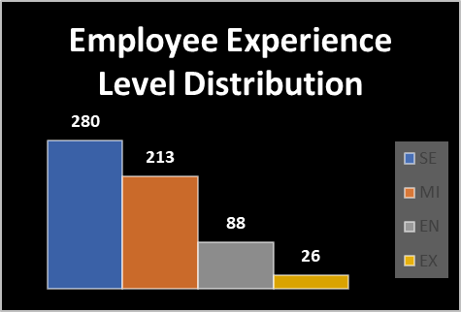
Distribution of Experience Levels
SELECT experience_level, COUNT(*) AS total_employees
FROM salaries
GROUP BY experience_level
ORDER BY total_employees DESC;
experience_level | total_employees
SE | 280
MI | 213
EN | 88
EX | 26

Slide 10
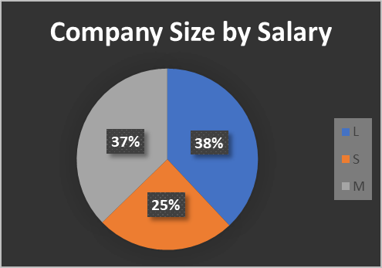
Average Salary by Company Size
SELECT company_size, AVG(salary_in_usd) AS avg_salary_usd
FROM salaries
GROUP BY company_size;
company_size | avg_salary_usd
L | $119,242.99
S | $77,632.67
M | $116,905.47

Slide 11
Top 5 Countries with the Highest Average Salaries
SELECT employee_residence, AVG(salary_in_usd) AS avg_salary_usd
FROM salaries
GROUP BY employee_residence
ORDER BY avg_salary_usd DESC
LIMIT 5;
employee_residence | avg_salary_usd
MY | $200,000.00
PR | $160,000.00
US | $149,194.12
NZ | $125,000.00
CH | $122,346.00

Slide 12
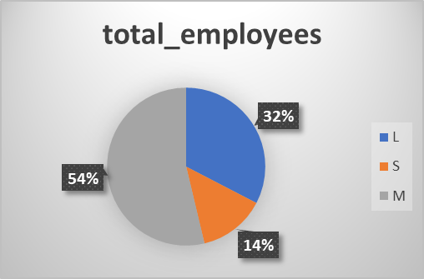
Count of Employees by Company Size
SELECT company_size, COUNT(*) AS total_employees
FROM salaries
GROUP BY company_size;
company_size | total_employees
L | 198
S | 83
M | 326

Slide 13
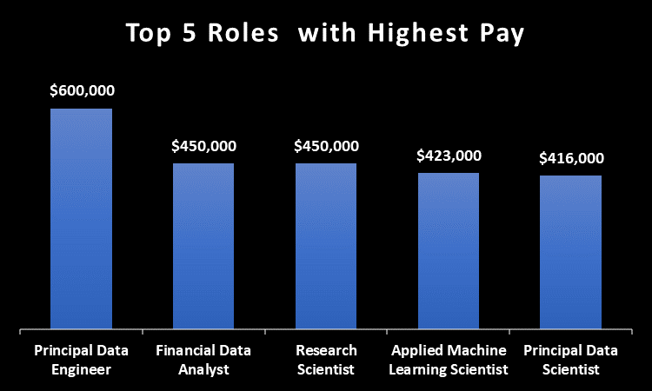
Highest Salaries Job Titles
SELECT job_title, MAX(salary_in_usd) AS highest_salary
FROM salaries
GROUP BY job_title
ORDER BY highest_salary DESC
LIMIT 5;
job_title | highest_salary
Principal Data Engineer | $600,000
Financial Data Analyst | $450,000
Research Scientist | $450,000
Applied Machine Learning Scientist | $423,000
Principal Data Scientist | $416,000

Slide 14
Distribution of Jobs by Remote Ratio
SELECT remote_ratio, COUNT(*) AS total_jobs
FROM salaries
GROUP BY remote_ratio
ORDER BY total_jobs DESC;
remote_ratio | total_jobs
0 | 127
50 | 99
100 | 381

Slide 15
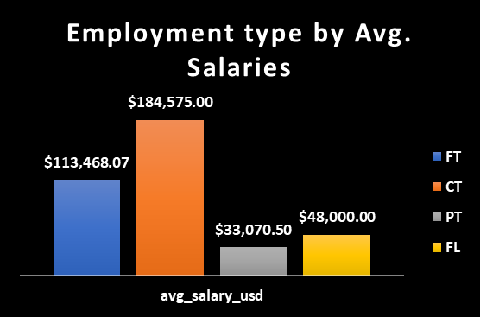
Average Salary by Employment Type
SELECT employment_type, AVG(salary_in_usd) AS avg_salary_usd
FROM salaries
GROUP BY employment_type;
employment_type | avg_salary_usd
FT | $113,468.07
CT | $184,575.00
PT | $33,070.50
FL | $48,000.00

Slide 16
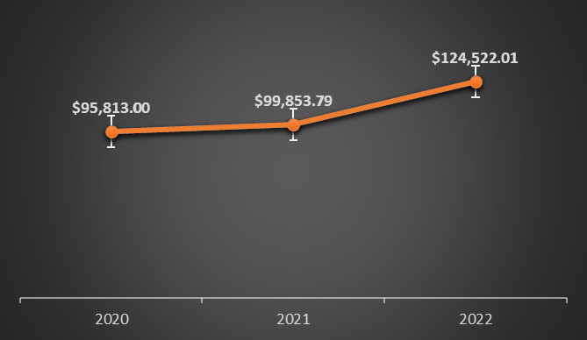
Salary Variation Year on Year
SELECT work_year, AVG(salary_in_usd) AS avg_salary_usd
FROM salaries
GROUP BY work_year
ORDER BY work_year;
work_year | avg_salary_usd
2020 | $95,813.00
2021 | $99,853.79
2022 | $124,522.01

Slide 17
Remote Work Flexibility by Job Title
SELECT job_title, AVG(remote_ratio) AS avg_remote_ratio
FROM salaries
GROUP BY job_title
ORDER BY avg_remote_ratio DESC;
job_title | avg_remote_ratio
Principal Data Analyst | 100
Lead Data Analyst | 100
Business Data Analyst | 90
Data Analytics Manager | 85.7143
Data Science Manager | 83.3333
Data Analyst | 75.2577
Financial Data Analyst | 75

Slide 18
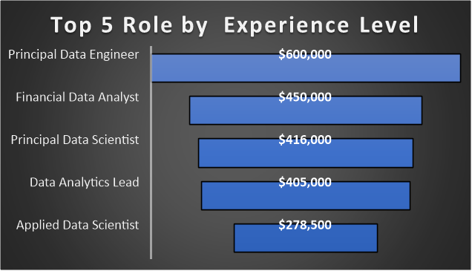
Top 5 Highest Paying Job Titles by Experience Level
SELECT experience_level, job_title, AVG(salary_in_usd) AS avg_salary_usd
FROM salaries
GROUP BY experience_level, job_title
ORDER BY avg_salary_usd DESC
LIMIT 5;
experience_level | job_title | avg_salary_usd
EX | Principal Data Engineer | $600,000
MI | Financial Data Analyst | $450,000
EX | Principal Data Scientist | $416,000
SE | Data Analytics Lead | $405,000
SE | Applied Data Scientist | $278,500

Slide 19
Correlation Between Salary and Job Flexibility
SELECT remote_ratio, AVG(salary_in_usd) AS avg_salary_usd
FROM salaries
GROUP BY remote_ratio
ORDER BY remote_ratio ASC;
remote_ratio | avg_salary_usd
0 | $106,354.62
50 | $80,823.03
100 | $122,457.45

Slide 20
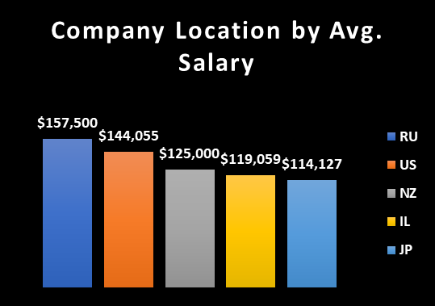
Average Salary by Company Location
SELECT company_location, AVG(salary_in_usd) AS avg_salary_usd
FROM salaries
GROUP BY company_location
ORDER BY avg_salary_usd DESC;
company_location | avg_salary_usd
RU | $157,500
US | $144,055
NZ | $125,000
IL | $119,059
JP | $114,127

Slide 21
Employee Distribution by Company Location.
SELECT company_location, COUNT(*) AS total_employees
FROM salaries
GROUP BY company_location
ORDER BY total_employees DESC;
company_location | total_employees
US | 355
GB | 47
CA | 30
DE | 28
IN | 24
FR | 15

Slide 22
Observations:
There is significant variation in average salaries across different job titles, with roles like Data Scientist earning higher salaries compared to roles like Data Analyst.
Experience level has a clear impact on salary, with senior-level positions earning significantly more than junior or mid-level roles.
Salaries vary widely by region, with employees in North America and Western Europe generally receiving higher compensation than those in other regions.
Roles with higher remote work ratios tend to have competitive salaries, suggesting that companies are willing to offer higher pay to attract talent who prefer remote work flexibility.
Larger companies typically offer higher average salaries compared to smaller companies, though some small companies also offer competitive salaries.

Slide 23
Recommendations:
Professionals seeking higher salaries should consider specializing in high-paying roles such as Data Scientist.
To achieve higher compensation, professionals should actively pursue opportunities for career progression and skill development.
Job seekers should be aware of geographic differences in pay and consider pursuing opportunities in higher-paying regions or remote positions.
Companies should consider offering remote work options to attract top talent, as it is increasingly valued by professionals.
Smaller companies should consider offering competitive salaries or unique benefits to attract talent, especially when competing with larger organizations.

